Slide 1
DECI Mental Health Project
By: Abdelrahman, Hassan, Aly.

Slide 2
Table of contents
01
Design Thinking
02
Features
03
Procedures
04
Outputs
About our users and their problems.
Ideation and Selection (MVP)
Normal and Trigger Procedures.
Our outputs and their types.

Slide 3
Whoa!
What can anybody do to make the lives of mentally disabled people? We got the answer.

Slide 4
Introduction
Mental health is a state of emotional and psychological well-being that empowers individuals to effectively manage the stresses of daily life, recognize and utilize their inherent abilities, achieve optimal learning and work performance, and actively contribute to their community.

Slide 5
01
Design Thinking
About our users and their problems.

Slide 6
Emphasize
Our users are mentally disabled people (no offense), and they have several characteristics.
They feel alone
They feel overwhelmed
They don’t understand their feelings

Slide 7
What causes mental illness?
Genetics
Childhood trauma
Unhealthy habits
Environment
Negative thoughts
Stress

Slide 8
Define
Tracking
Accessibility
Our users need to track their moods and know why they experience certain feelings, which can be hard for our users.
Scheduling a therapy session might feel overwhelming at times, which deters people in need of a therapy session.

Slide 9
02
Features of our MVP

Slide 10
Features of the MVP
Mood Tracking
Community
Breathing Exercises
Therapy Sessions
Venus is the second planet from the Sun
Provide users with a place to feel belonged to.
Provide users with an interactive breathing exercise.
We give users the option to book therapy sessions easily.

Slide 11
What our Therapists do
Listen
Give support
Don’t judge
Professional help

Slide 12
Procedures
Normal
User will sign up or login, providing helpful details.
User would track his mood throughout the month
Trigger
Whenever the user or therapist feel an appointment is needed, they would schedule.
If user wants to view past moods, they can do so by going to the mood tracking.
To see all appointments, click on the calendar icon.

Slide 13
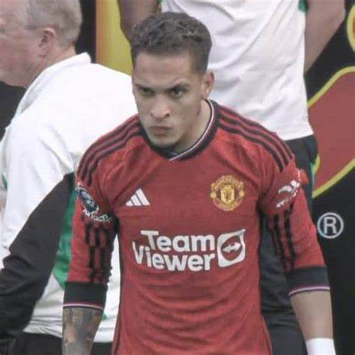
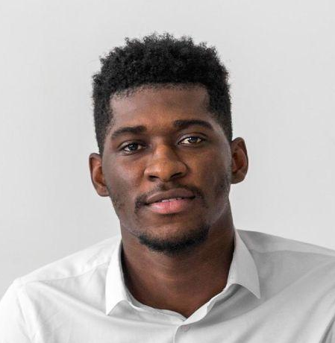
Our doctors
Dr. Anthony
Dr. White
Easily connects and relates to teens, providing a comfortable experience.
Suitable for adults.

Slide 14
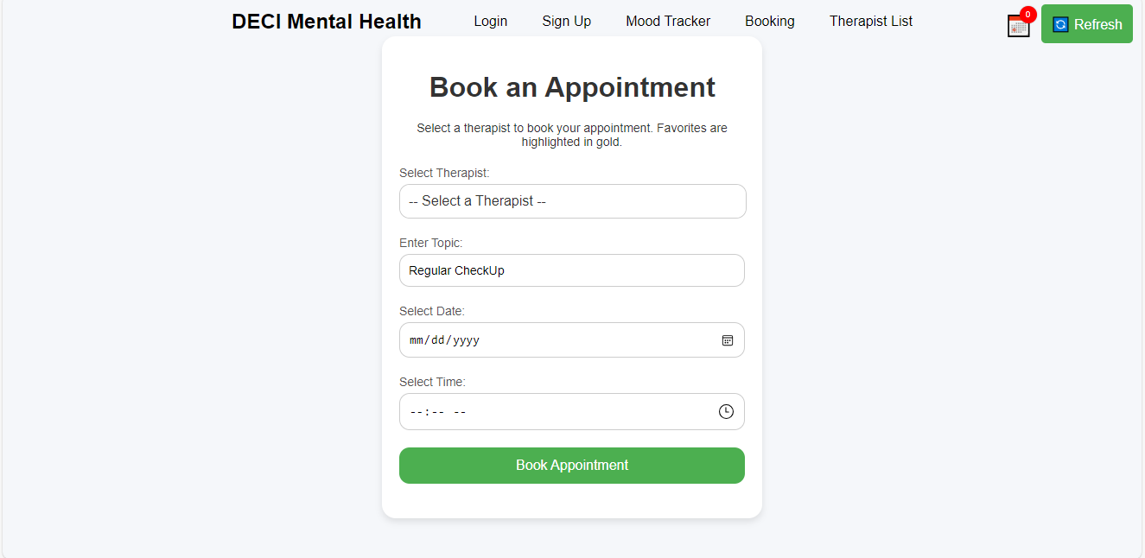
Our Website
Our website is our minimum viable product. Take a look! We’re sure you’ll like it ☺.

